Slide 1
Tesla stock prediction
Mohamed Zayyan Variawa

Slide 2
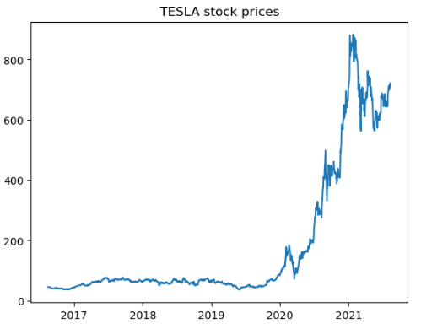
Context: The dataset contains Tesla stock prices between 2016 and 2021.
Dataset metadata:
Days: 1258
Features: 7 (including Date)
Trend:

Slide 3
Methodology (univariate problem)
Data pre-processing:
Check for any nulls: There are no missing values
Scale the Close price column: Using sklearns StandardScaler
Part 1: Univariate problem
Using only the previous Close prices to predict the future Close price
Using a time_step of 7, create sequences of data where the previous 7 days of Close prices will be used to predict the 8th days Close price
80% Train, 20% Test
20% of Train data used as validation split during training

Slide 4
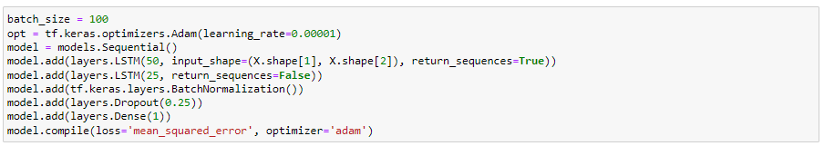
Methodology (univariate problem)
Model architecture and hyper-parameters:

Slide 5
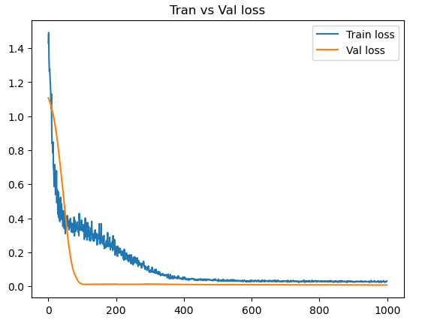
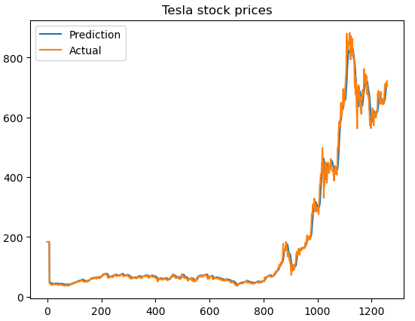
Results (univariate problem)
Train vs Val loss
Prediction vs Actual

Slide 6
Methodology (multivariate problem)
Data pre-processing:
Check for any nulls: There are no missing values
Scale the Close price column: Using sklearns StandardScaler
Part 1: Multivariate problem
Using all the previous features (i.e. Close, Open, Volume etc) to predict the future Close price
Using a time_step of 7, create sequences of data where the previous 7 days of features prices will be used to predict the 8th days Close price
80% Train, 20% Test
20% of Train data used as validation split during training

Slide 7
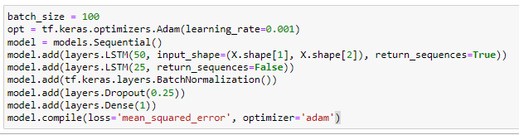
Methodology (multivariate problem)
Model architecture and hyper-parameters:

Slide 8
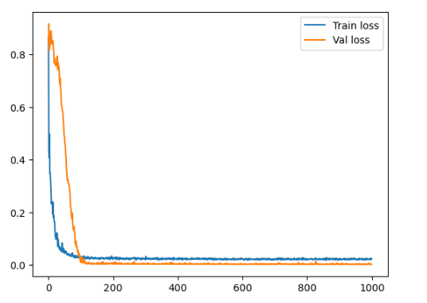
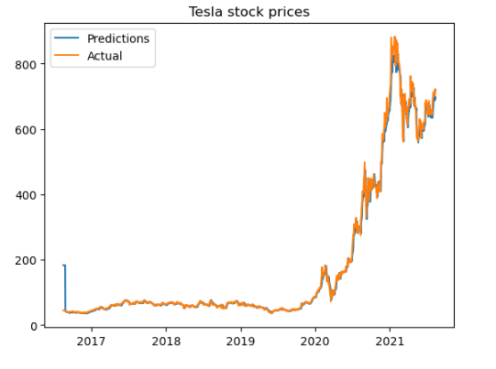
Results (multivariate problem)
Train vs Val loss
Prediction vs Actual

Slide 9
Conclusions
Both the univariate and multivariate problems have shown the ability to accurately forecast Tesla stock prices using a time step of 7
This would indicate that using multiple features is not necessarily a better strategy for forecasting Tesla stock prices

